Slide 1


ROCK PAPER SCISSOR AI GAME

Slide 2

AGENDA
Title Page
Introduction
Methodology
code Typed
Screen Shots Output photo pasted

Slide 3
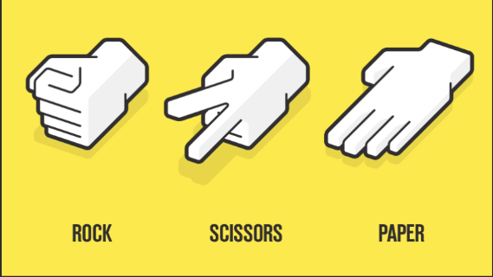
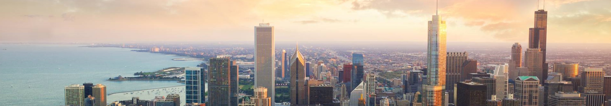
What is Rock-Paper-Scissors?

Slide 4

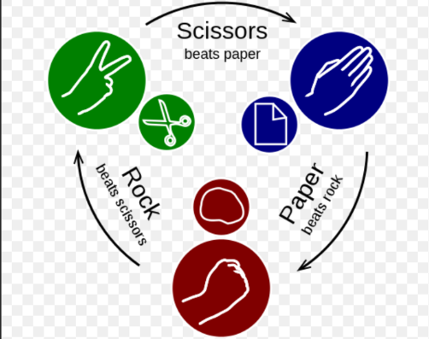
ROCK PAPER SCISSOR….. Rock, paper, scissors is a simple and popular hand game played between two people. It is often used for fun, decision-making, and even strategic competitions. The game is based on three hand gestures: rock (✊): A closed fist, which beats scissors. Paper (✋): an open hand, which beats rock. Scissors (✌): A fist with the index and middle fingers extended, which beats paper.
Why Implement AI for the Game?
Predicting player behaviour.
Enhancing strategy development.
Teaching game theory.
Entertainment & challenge.
Real-world applications.

Slide 5

Methodology
Step 1: Taking User Input
The user selects one of three choices: Rock, Paper, or Scissors.
Input is validated to ensure correct selection.
Step 2: AI Selection
The AI generates a random choice using Python’s random.choice() function.
This ensures unpredictability in AI behavior.
Step 3: Decision-Making Process
The player’s choice and the AI’s choice are compared.
The winner is determined using a set of conditional if-else statements:
Rock beats Scissors
Scissors beats Paper
Paper beats Rock
If both choices are the same, it's a tie.
Step 4: Displaying Results
The choices of both the player and AI are displayed.
The winner is announced accordingly.
Step 5: Repeating the Game (Optional)
A loop can be implemented to allow multiple rounds.
Flowchart Representation
A visual flowchart can be used to illustrate the process of input, AI selection, decision-making, and output.

Slide 6
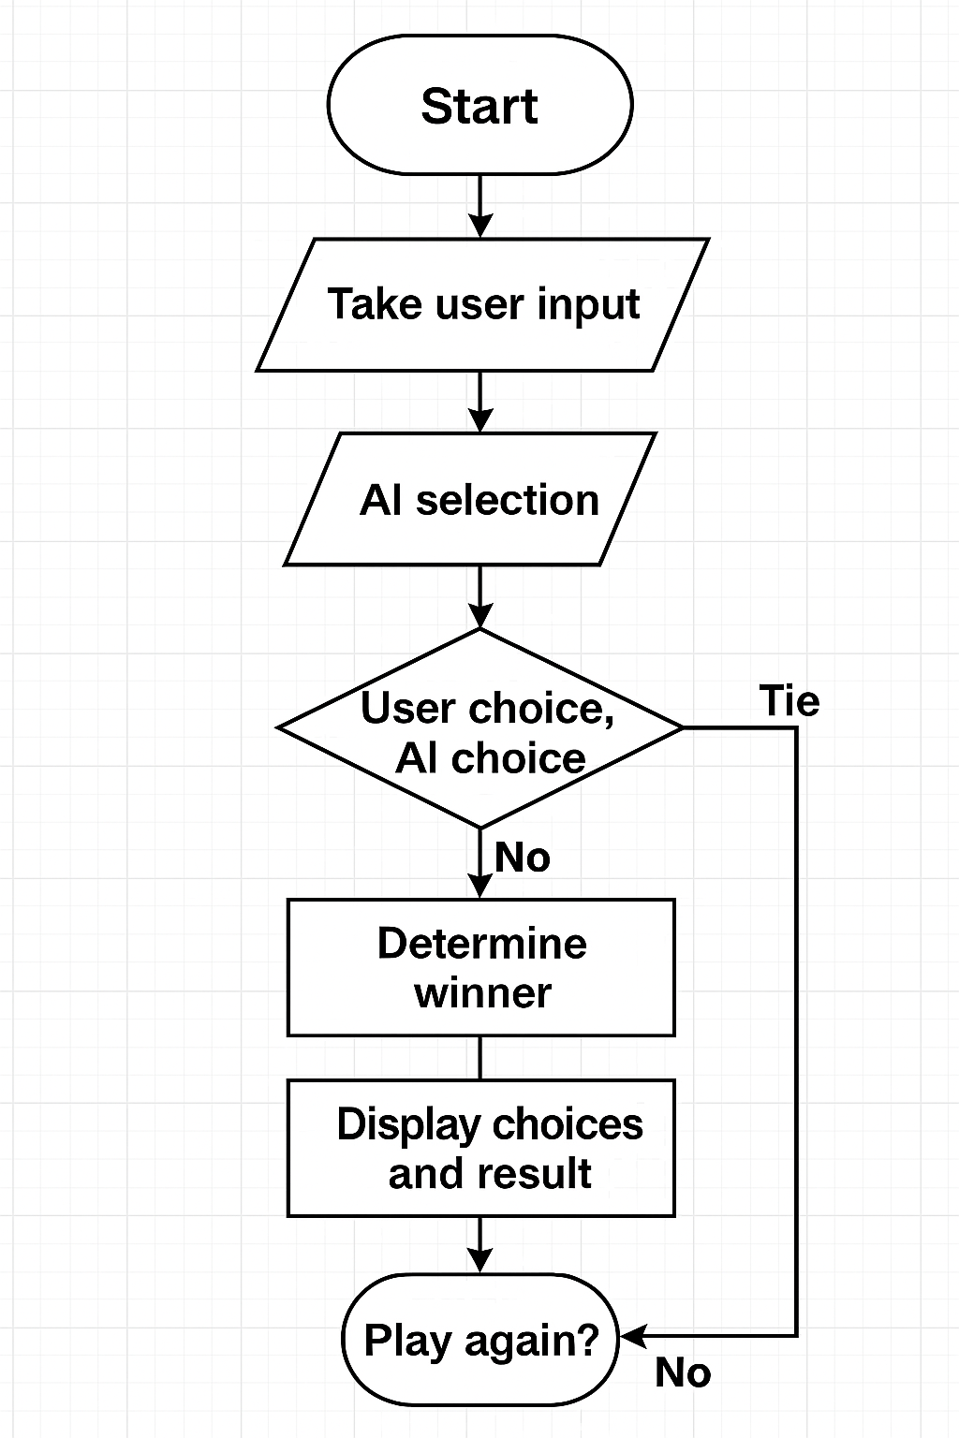
FLOW CHART…

Slide 7
CODETYPED…. running = Truewhile running: screen.fill(DARK_ORANGE) # Background color changed to DARK ORANGE # Heading heading_text = font_large.render("Rock Paper Scissors!", True, BLACK) screen.blit(heading_text, (WIDTH // 3, 20)) # Score Display (Color is BLACK) score_text = font_medium.render(f"Score - You: {score_player} | Computer: {score_computer}", True, BLACK) screen.blit(score_text, (WIDTH // 3, 80)) # Display Choices with Black Border screen.blit(rock_img, (100, 200)) screen.blit(paper_img, (325, 200)) screen.blit(scissors_img, (550, 200)) # Display 'You Choose' and 'Computer Choose' player_text = font_medium.render("You Choose:", True, BLACK) screen.blit(player_text, (100, 400)) choice_text = font_medium.render(player_choice, True, YELLOW) screen.blit(choice_text, (280, 400)) computer_text = font_medium.render("Computer Choose:", True, BLACK) screen.blit(computer_text, (100, 450)) comp_choice_text = font_medium.render(computer_choice, True, YELLOW) screen.blit(comp_choice_text, (380, 450)) # Display Result result_display = font_large.render(result_text, True, result_color) screen.blit(result_display, (WIDTH // 3, 500)) # Draw history box pygame.draw.rect(screen, BLACK, (800, 50, 180, 500), 5) # Black border for history section history_title = font_medium.render("History", True, BLACK) screen.blit(history_title, (850, 60))
# Display last 5 rounds in history (in 2-line format) y_offset = 100 for round_result in history[-5:]: # Show only last 5 rounds # Split round_result into two lines for player and computer player_line = font_small.render(f"You: {round_result[0]}", True, BLACK) computer_line = font_small.render(f"Computer: {round_result[1]}", True, BLACK) screen.blit(player_line, (810, y_offset)) screen.blit(computer_line, (810, y_offset + 20)) y_offset += 40 # Adjust spacing for compact display pygame.display.flip() for event in pygame.event.get(): if event.type == pygame.QUIT: running = False elif event.type == pygame.MOUSEBUTTONDOWN: x, y = event.pos if 100 <= x <= 250 and 200 <= y <= 350: player_choice = "rock" elif 325 <= x <= 475 and 200 <= y <= 350: player_choice = "paper" elif 550 <= x <= 700 and 200 <= y <= 350: player_choice = "scissors" if player_choice: computer_choice = random.choice(choices) if player_choice == computer_choice: result_text = "It's a Draw!" result_color = BLUE # BLUE for "It's a Draw!" history.append((player_choice, computer_choice)) # Add to history as tuple elif (player_choice == "rock" and computer_choice == "scissors") or \ (player_choice == "paper" and computer_choice == "rock") or \ (player_choice == "scissors" and computer_choice == "paper"): result_text = "You Win!" result_color = RED # RED for "You Win!" score_player += 1 history.append((player_choice, computer_choice)) # Add to history as tuple else: result_text = "You Lose!" result_color = RED # RED for "You Lose!" score_computer += 1 history.append((player_choice, computer_choice)) # Add to history as tuplepygame.quit()

Slide 8
CODE TYPED…..
import pygameimport random# Initialize pygamepygame.init()# ColorsDARK_ORANGE = (255, 140, 0) # Dark Orange BackgroundWHITE = (255, 255, 255)BLACK = (0, 0, 0)RED = (255, 0, 0) # RED for "You Win!" and "You Lose!"YELLOW = (255, 255, 0)GREEN = (0, 255, 0)BLUE = (0, 0, 255) # BLUE for "It's a Draw!"# Screen settingsWIDTH, HEIGHT = 1000, 600 # Increased width for history sectionscreen = pygame.display.set_mode((WIDTH, HEIGHT))pygame.display.set_caption("Rock Paper Scissors - Ultimate Edition")# Load imagesrock_img = pygame.image.load("rock.png")paper_img = pygame.image.load("paper.png")scissors_img = pygame.image.load("scissors.png")
# Resize imagesimg_size = (150, 150)rock_img = pygame.transform.scale(rock_img, img_size)paper_img = pygame.transform.scale(paper_img, img_size)scissors_img = pygame.transform.scale(scissors_img, img_size)# Function to add a black border to imagesdef add_border(image, border_color=BLACK, border_width=5): bordered_img = pygame.Surface((img_size[0] + 2 * border_width, img_size[1] + 2 * border_width)) bordered_img.fill(border_color) bordered_img.blit(image, (border_width, border_width)) return bordered_img# Apply black border to imagesrock_img = add_border(rock_img)paper_img = add_border(paper_img)scissors_img = add_border(scissors_img)# Font settingsfont_large = pygame.font.Font(None, 60)font_medium = pygame.font.Font(None, 40)font_small = pygame.font.Font(None, 28)# Game variablesscore_player = 0score_computer = 0choices = ["rock", "paper", "scissors"]player_choice = ""computer_choice = ""result_text = ""result_color = YELLOW # Default color for result texthistory = [] # List to store history of last 5 rounds

Slide 9

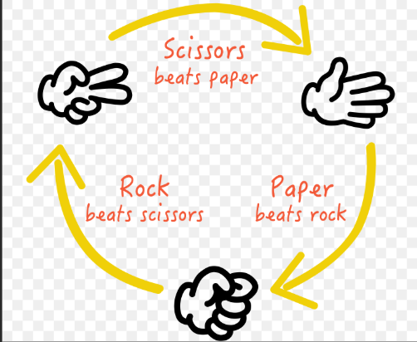
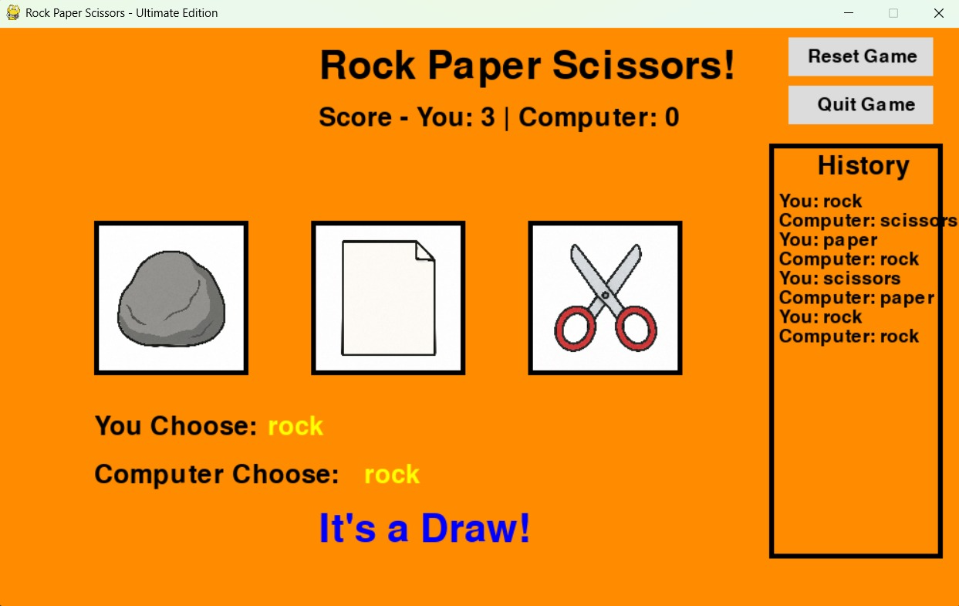
SCREENSHOTS…

Slide 10
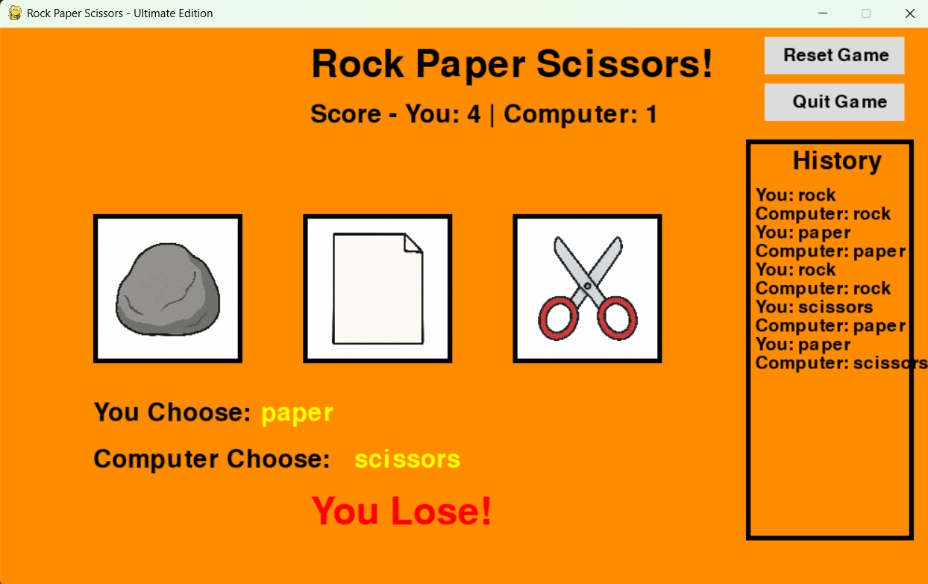
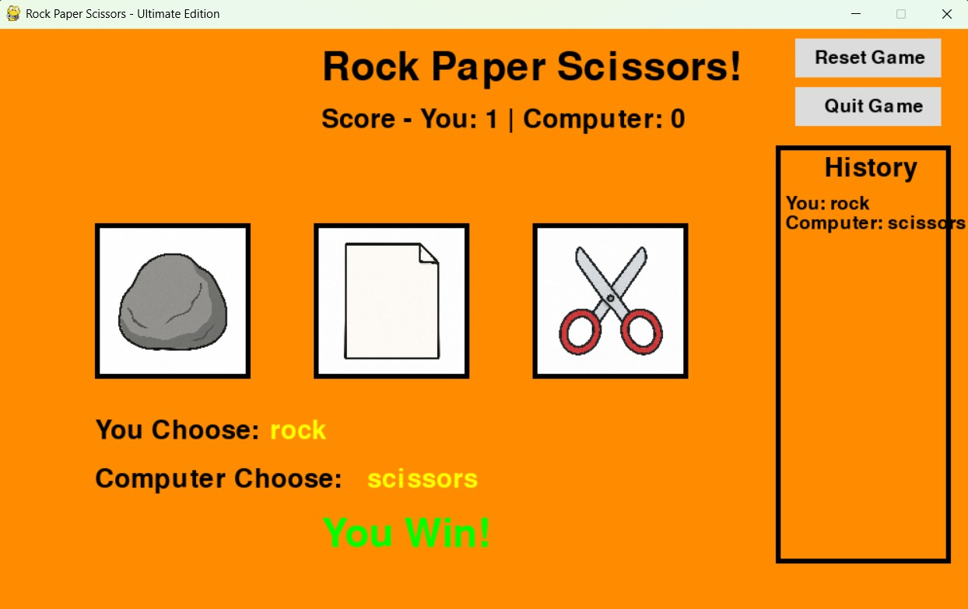

Slide 11

SCREEN SHOTS….

Slide 12
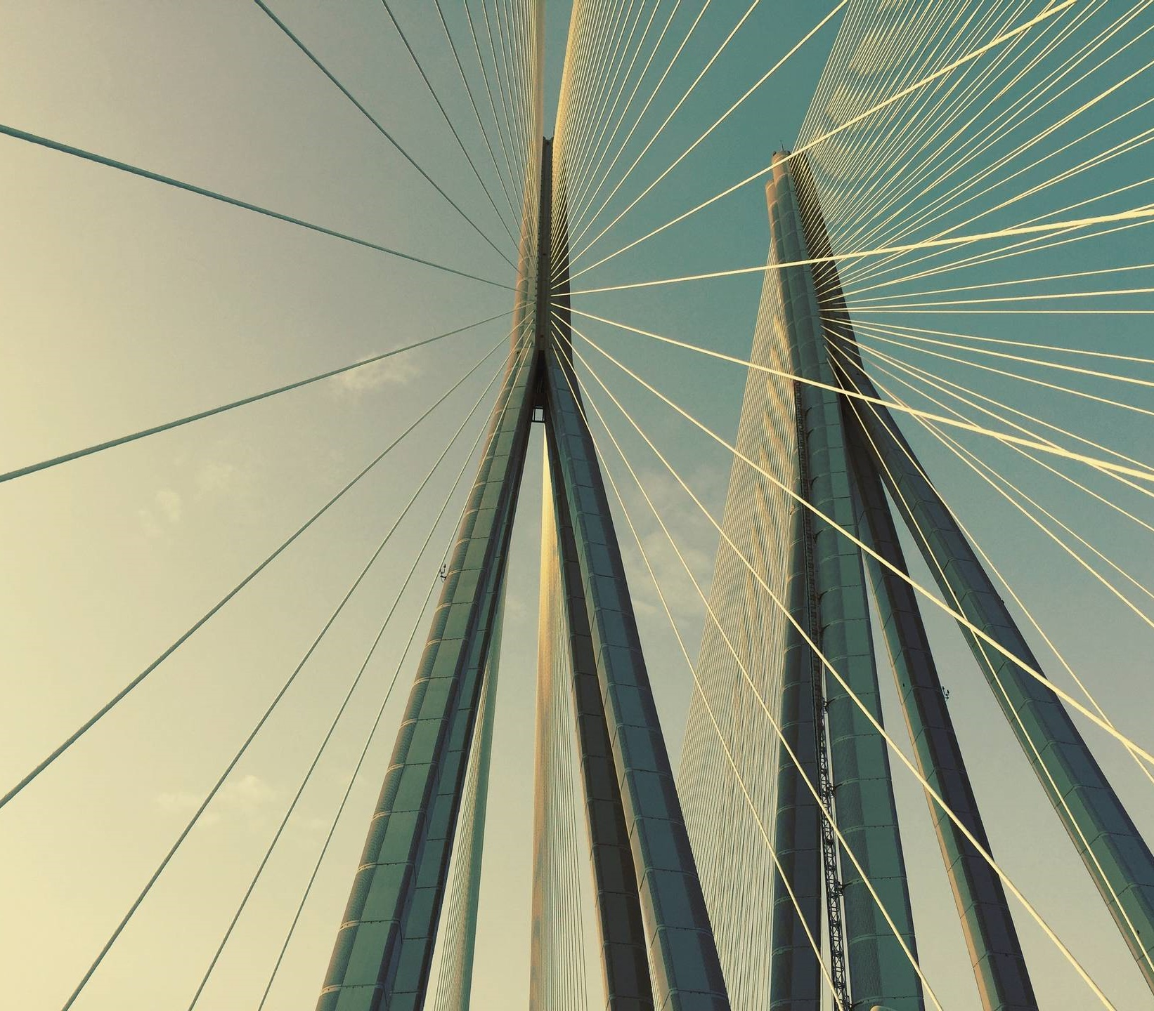
THANK YOU

